Slide 1
Climate communication, policy, and equity
Week 14?!

Slide 2
Today’s Agenda
Meditation
1
Reflection on yesterday’s Q&A with Ira Harkavy
2
3
Reading Discussion
Break (chibes)
4
Session(s) planning
5

Slide 3

Meditation

Slide 4
Reflection on yesterday’s Q&A with Ira Harkavy

Slide 5
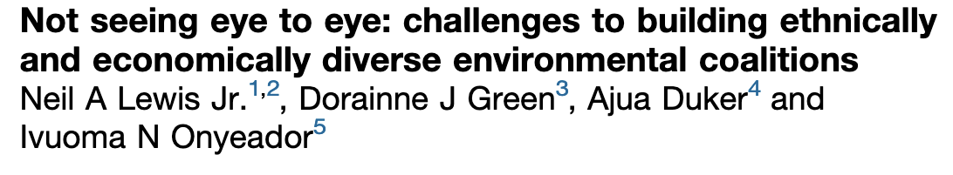
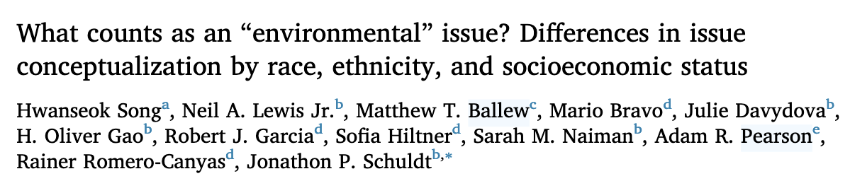

Slide 6
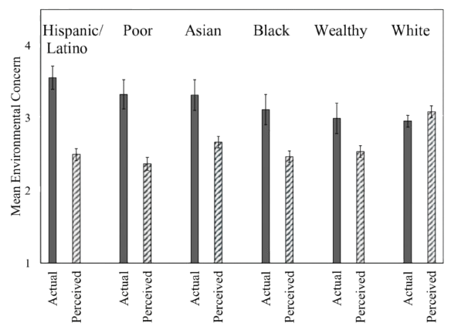
There is an environmental belief paradox
Pearson et al. (2018)

Slide 7
Questions
How can we make diverse coalitions a reality?

Slide 8
Questions
How can we make diverse coalitions a reality?
What kinds of “everyday interventions” might actually shift perceptions and build trust?

Slide 9
Questions
How can we make diverse coalitions a reality?
What kinds of “everyday interventions” might actually shift perceptions and build trust?
What role can climate communication play in coalition-building across groups?

Slide 10
Questions
How can we make diverse coalitions a reality?
What kinds of “everyday interventions” might actually shift perceptions and build trust?
What role can climate communication play in coalition-building across groups?
The authors tend to use misperceptions and trust interchangeably. Should we think of them as interchangeable?

Slide 11
Questions
How can we make diverse coalitions a reality?
What kinds of “everyday interventions” might actually shift perceptions and build trust?
What role can climate communication play in coalition-building across groups?
The authors tend to use misperceptions and trust interchangeably. Should we think of them as interchangeable?
Does the eco vs. human-oriented framing help clarify or oversimplify? What are the pros and cons of labeling groups based on these?

Slide 12
Questions
How can we make diverse coalitions a reality?
What kinds of “everyday interventions” might actually shift perceptions and build trust?
What role can climate communication play in coalition-building across groups?
The authors tend to use misperceptions and trust interchangeably. Should we think of them as interchangeable?
Does the eco vs. human-oriented framing help clarify or oversimplify? What are the pros and cons of labeling groups based on these?
Is this conversation about what counts as environmental in a climate change context, or are we actually grappling with entirely different definitions of what environmental means?

Slide 13
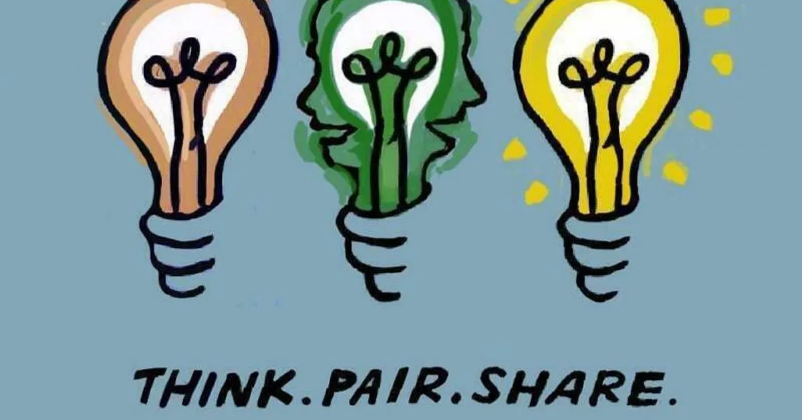

Slide 14
How do the themes from Song et al. and Lewis et al. intersect with YPAR?
What do you think results from the Song et al. paper would look like in a youth sample? In students at Sayre?
The papers were focused on adults, but what youth about youth? What can youth bring to environmental coalitions?
How can our research approaches and tools be adapted to reflect community/youth definitions of environmental issues?
How might YPAR principles or YPAR itself lead to diverse coalition formation?

Slide 15
Break
Chibes

Slide 16
Session(s) Planning
March 21 & March 23

